Slide 1
An Analysis on US Twitter Data in Relation to COVID-19 Pandemic

Slide 2
The US Response to COVID-19
Due to a lack of transparency, as well as misplaced priorities, by some officials the US response to COVID-19 was wavering and delayed.
presented Americans with mixed messages that shaped:
moral intensity: the degree of feeling that a person has about the consequences of a moral choice
ethical decision-making i.e compliance to social distancing and other safety protocols

Slide 3
Formulation of Research Objective
Questions:
What is the general public’s level of concern for the spreading virus?
Are they threatened? Morally aware? Skeptical?
While moral intensity plays a role in human mobility, is this sentiment an accurate predictor for COVID-19 deaths?
Hypothesis:
More well-educated people tend to use more complex language and less educated people tend to use less complex language
Morality is related to level of education
Potential Pain Points:
Can we use the readability of the written content in each tweet to deduce number of coronavirus deaths?

Slide 4
The Objective
To determine whether moral intensity and readability are significantly correlated to COVID-19 deaths and can be used to accurately predict future trends based on tweets in the US

Slide 5
Data Acquisition
Data was acquired from multiple sources and combined into a single dataframe for analysis.
Sources:
Sample Twitter Data from 2/01 - 4/10
COVID-19 deaths by week per state from the CDC website
Table of U.S. States and Abbreviations from Wikipedia (Included Population, Water Area (mi^2), and Land Area (mi^2) for each State)
Table of Airports by State from Wikipedia.

Slide 6
Data Cleaning
Twitter Data:
Removed all non-english tweets from the dataframe
Removed all non-ASCII characters, URLs, retweets, and empty white spaces from the text using text parsing functions in R (stringr)
Removed non-ASCII characters from locations to make them easier to parse
Removed extraneous data columns to create a more concise data frame
Covid-19 Death Data:
Removed all data for weeks ending before 2/01 and after 4/11
Removed all data not pertaining to US states
Grouped all weekly COVID-19 deaths by state and found the sum to create a new dataframe of total Covid Deaths for time period by state

Slide 7
Sentiment Calculation
Broke up every Twitter text into a vector of individual words and combined each new vector to a vector of total words in the text
Created a frequency table of words using the total words vector to show most commonly used words
Manually looked through the list to find words that would most commonly be associated with the view that COVID-19 was not a major threat (negative sentiment) and the view that COVID-19 was a major threat to public health (positive sentiment)
Using these words created a small sentiment dictionary then parsed all twitter text to assign a sentiment score for each tweet.
Every word that was in the positive sentiment dictionary increased the score by one point and every word in the negative dictionary decreased the score by one point

Slide 8
Measuring Readability: Using A Flesch Reading Score & Getting User Locations
Used cleaned Twitter text data to calculate a vector Flesch Reading Scores for each Twitter datapoint then added the vector as a column in the twitter data frame.
Parsed the location column of the Twitter dataset using the data frame of state names and abbreviations and kept any matches, throwing out the rest.
Each match was assigned a state number which was later used to match a state name for each remaining datapoint
Some double matches were found (state contained the name of another state like West Virginia or multiple states listed), however those were dealt with manually as there weren’t very many
RE=206.835-1.015(#Words/#Sentences)-84.6(#Syllables/#Words)
# Sentences was set to 1 to accommodate the short text format of tweets

Slide 9
Combining Data Frames
Each of our 3 final dataframes (tweets, airports by state, and Covid deaths by state) had a state variable attached to each datapoint
Used the join family of R functions in the Dplyr library to join all three data frames by each state.
The tweet data frame was used as the base dataframe and rows from other data frames were added based on the value of the state variable.
A Small Example:

Slide 10
Creating a Linear Model
First created a model using all of the data available to predict COVID-19 Deaths (FRE, Sentiment, Population, Airports, Water Area, & Land Area)
Used diagnostic and marginal model plots to assess validity of the dataframe and found some major issues with the Residuals Plot, Scale Location, and QQPlot
This indicated issues with the trend, normality, and constant variance of conditions of our model
Used an inverse response plot to find the best transformation for the response variable (covid deaths), which produced a lambda of 0.263725 ~ ¼
Transformed the model using (covid_deaths)^(¼) as our response variable

Slide 11
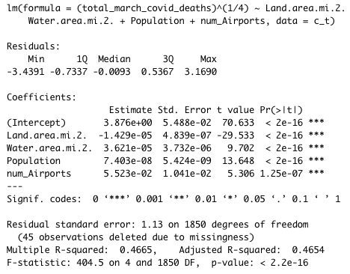
Finding a Linear Model (cont’d)
Even in our new model, FRE and Sentiment was not significantly correlated with COVID-19 Deaths, therefore we cannot definitively say there is any relationship between the variables
Next used exhaustive stepwise regression to find the best model, and selected a combination of number of airports, population, land area, and water area as the best predictor for COVID-19 Deaths as our best model
Our final model can be seen here:

Slide 12
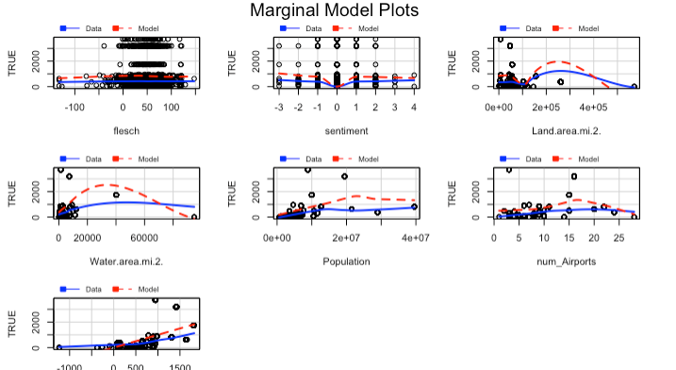
Original Model Plots

Slide 13
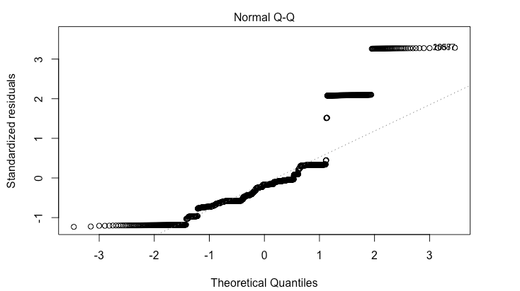
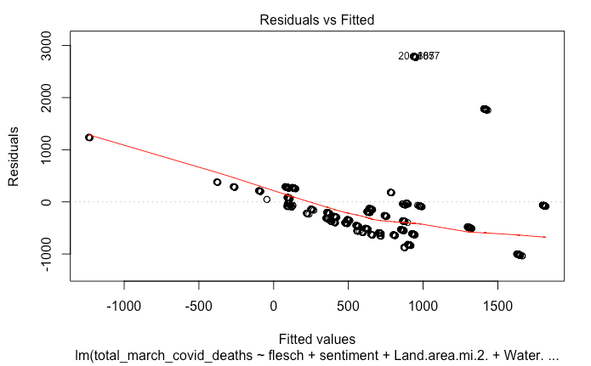
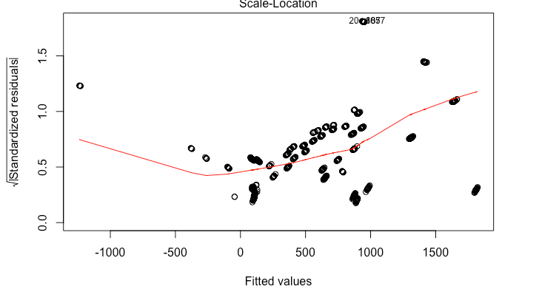
Original Model Plots (cont’d)

Slide 14
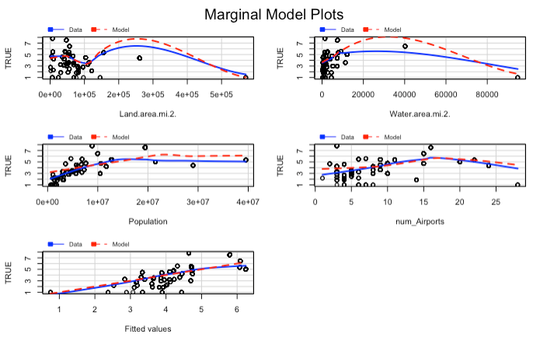
Final Model Plots

Slide 15
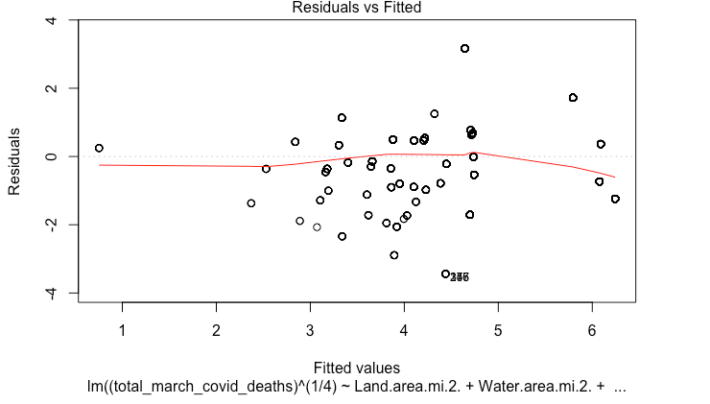
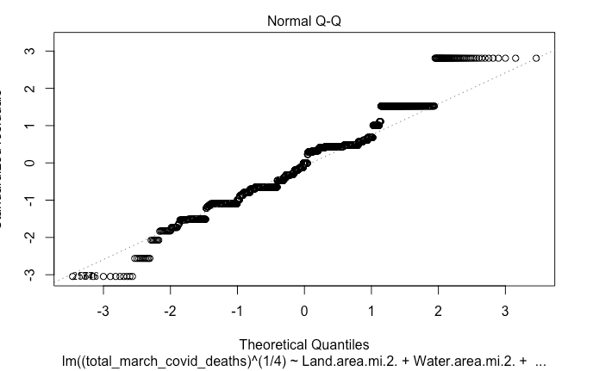
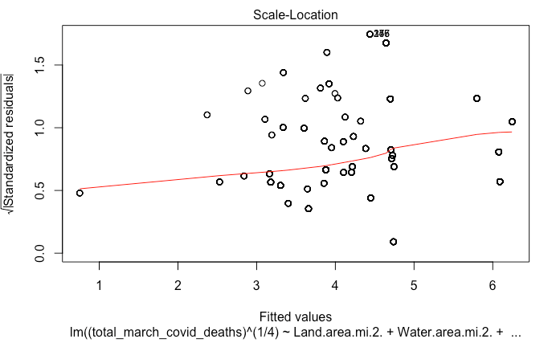
Final Model Plots (cont’d)

Slide 16
Conclusion
Based on the results from this study, we were unable to find any significant correlation between our target measurements and number of Covid deaths.
This could very well be due to issues with our data:
All of our models had troublesome QQ Plots, which indicates that our data was not normally distributed.
This could be due to trouble with the location parser, as it only recognized state names and abbreviations, severely limiting the location data available.
It could be that certain states were underrepresented due to our simplistic parser leading to a skew in our data.
Due to time constraints, I created only a rudimentary sentiment library, however, counting the number of “bad” and “good” is not an accurate measure of sentiment as it doesn’t take into account the complexities of the English language
Further, the number of COVID-19 deaths were treated as static for simplicity when it was in fact changing week by week

